Slide 1
Skill Extraction from Job Descriptions
Finding important skills from job descriptions using NLP and Machine Learning
Full-stack Data Science Project | Notebook + FastAPI + React + Power BI

Slide 2
THE CHALLENGE
Problem Statement
Job descriptions contain important skills inside long and unstructured text.
Finding these skills manually from thousands of job postings takes a lot of time.
Skills are mixed with other information like responsibilities, benefits and company details.
2,412
real job postings analyzed in this project
?
Manual review does not scale past a handful of postings.
1.92
~
Free-text mixes company culture, benefits, and requirements together.
avg. skills detected per posting (dictionary method)

Slide 3
WHY IT MATTERS
Business Use Case
Recruiters
Workforce Planners
Job Seekers
Find which skills are most needed for different jobs and locations, so recruiters can find the right candidates easily.
Identify which skills are becoming more or less popular, so organizations can plan better training programs.
Understand which skills are commonly required for a particular job.

Slide 4
DATA
Dataset
postings.csv — real LinkedIn-style job postings
Dataset Snapshot
Field | Description
job_id, title, company_name | Identifiers
description | Raw job description text (primary field)
location, work_type | Posting metadata
formatted_experience_level | Required experience level
Rows loaded
2,500
After de-dup / cleaning
2,412
Missing company_name
35
Missing experience level
527
Duplicate job_id
0

Slide 5
PREPROCESSING PIPELINE
Data Cleaning
1
Strip HTML tags
2
Remove URLs & emails
3
Remove phone numbers
4
Strip special characters (keep + # . for tech terms)
5
Collapse whitespace
6
Lowercase & drop duplicate/empty descriptions

Slide 6
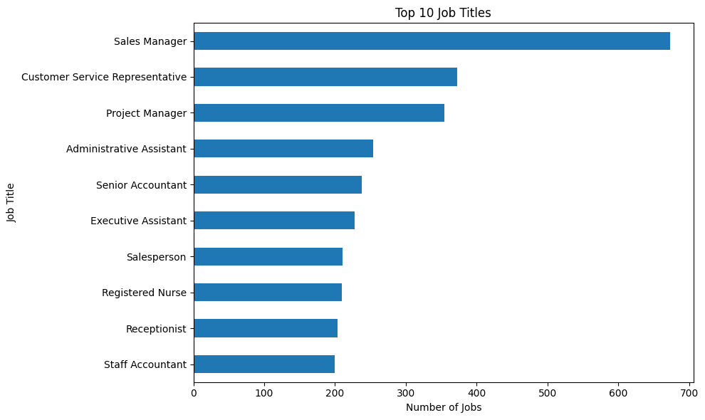
UNDERSTANDING THE DATA
Exploratory Data Analysis
I checked:
Number of job postings
Job titles
Job locations
Description length
Most common skills
Missing values
This helped to understand the data before extracting skills.
These are the skills that appear most often in our job postings.

Slide 7
END-TO-END FLOW
NLP Pipeline
Raw JD
→
Cleaning
→
Tokenize +
Stopwords
→
7 Extraction
Methods
→
Normalize
→
Structured
Output
First, we take the raw job description and clean it. Then we process the text, extract skills using different methods, make the skill names consistent, and create structured skill data.

Slide 8
DICTIONARY + REGEX
Rule-Based Approach
Dictionary Matching
Regex / Phrase Matching
Regex means Regular Expression and is used to find specific patterns in text.
It helps us identify different forms and phrases of a skill.
It can handle cases such as “Python 3”, “machine-learning” and “Power BI”.
This helps find skill mentions that a simple dictionary match may miss.
Regex improves coverage, but some variations may still be missed.
We created a skill taxonomy containing 40 common skills and their aliases.
The system checks each job description against this predefined skill list.
If a skill or its known alias is found, it is extracted.
We use word boundaries so that partial or incorrect matches can be avoided.
This method is simple, fast and accurate for skills already present in our taxonomy.
Example - "We require a Data Scientist with Python, Pandas, NumPy, Scikit-learn, SQL and AWS experience."
Example - “Experience with Python 3, machine-learning and Power BI.”
Extracted : AWS, NumPy, Pandas, Python, SQL, Scikit-learn
Extracted : Python, Machine Learning, Power BI

Slide 9
WEAK-SUPERVISED CLASSIFIER
Machine Learning Approach
Pipeline: TF-IDF (3,000 features) → Logistic Regression → predicted skill category, trained on weak labels derived from dictionary-matched skills per posting.
Why weak labels?
We did not have a manually labelled dataset.
So, we used the skills found by the Dictionary method to create labels for the ML model.
These labels are approximate and are not manually verified.
We used 75% data for training and 25% for testing.

Slide 10
CONTEXTUAL NLP
Transformer Approach
Traditional NLP → TF-IDF → Word Embeddings → NER → Transformers
Transformers understand the meaning of words using the surrounding text.
They can handle cases where the same word may have different meanings.
Live in the application
A pretrained BERT-based NER model is used in our FastAPI backend.
Its results can be compared with Dictionary, Regex and spaCy NER

Slide 11
METHODS EVALUATED HEAD-TO-HEAD
Model Comparison
Sr.no | Method | Precision | Recall | F1 score | Average Time | N Scored
1 | Dictionary Matching | 1.000 | 0.903 | 0.949 | 0.529 | 2412
2 | Regex | 1.000 | 1.000 | 1.000 | 39.316 | 2412
3 | TF-IDF (proxy) | 0.875 | 0.875 | 0.875 | 0.320 | 200
4 | ML Classifier (Weak Labeled) | 1.000 | 1.000 | 1.000 | 153.933 | 200
5 | Transformer | 0.996 | 0.998 | 0.998 | 242.851 | 200

Slide 12
WHERE METHODS DISAGREE
Error Analysis
!
Partial Entity
"Python programming" extracted instead of canonical "Python"
!
Synonym Problem
"ML" not recognized as "Machine Learning" by exact matching
!
Wrong Entity
"AWS Cloud" captured as one unit instead of "AWS"
!
Spelling Problem
Types like "Pyhton" matching nothing in the taxonomy

Slide 13
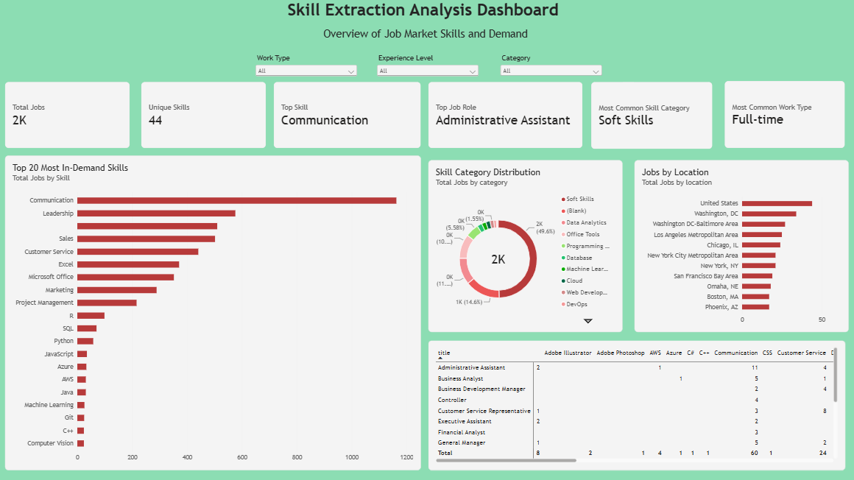
POWER BI ANALYTICS
Dashboard

Slide 14
REACT + FASTAPI
Application Demo
Dashboard
Analyzer
Shows important numbers and top skills.
Paste a JD, get skills instantly
Comparison
Job Explorer
Dictionary vs Regex vs NER vs Transformer
Search & filter 2,412 postings

Slide 15
KEY TAKEAWAYS
Conclusion
✓
Dictionary matching gives perfect precision on known terms; Regex extends coverage to phrase/version variants at a small recall cost (F1 = 0.949).
✓
TF-IDF is a strong candidate-generator, not a standalone labeled extractor — only ~a fraction of its top terms are true skills.
✓
A weak-supervised ML classifier demonstrates that even noisy proxy labels let a simple model learn a useful signal.
✓
Combining rule-based precision (Dictionary/Regex) with contextual models (NER/Transformer) balances precision and coverage better than any single method alone.

Slide 16
Future Improvements
Where this project goes next
• Extend model_comparison.csv with measured precision/recall/F1 for NER and Transformer, now that both run live in the backend
• Replace weak-supervision labels with a small hand-annotated gold set
• Expand the skill taxonomy using top TF-IDF/n-gram candidates not yet catalogued
• Add a feedback loop: let recruiters confirm/reject extracted skills to retrain the classifier

